Slide 1
Political Correctness: The New Morality
Gateway Baptist Church
16 October 2017

Slide 2
Introductions
What is your name?
What is the name of a fond relative or distant friend and why did you mention that person (very briefly)?

Slide 3
Why We Are Here
If your religion is so great, it can withstand some questioning.
“That sums up my problem with Scientology—despite its claims to the contrary, the practice doesn’t help you better the world or even yourself; it only helps you be a better Scientologist.” ― Leah Remini, Troublemaker: Surviving Hollywood and Scientology

Slide 4
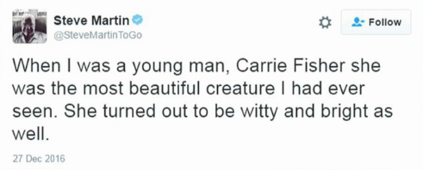
PC: What’s wrong with it?
Why did he delete it?

Slide 5
PC: What’s wrong with it? Some Google results
I love political correctness | 5,690 results
I love coffee | 1,730,000 results
I love stuff | 3,950,000 results
I love morality | 25,900 results
I love hard work | 611,000 results
I love taxes | 33,800 results
I love kale | 321,000 results

Slide 6
Discussion 1
PC: What’s wrong with it?
Possibly:
Reduced conversation
Reduced freedom of expression
Redefining harassment, assault
If the discussion gets too off topic, find the commonality with then topic or just reset back.
Try to get the widest perspectives from all the group.
Tease out good ideas
Provide a summary of your answers

Slide 7
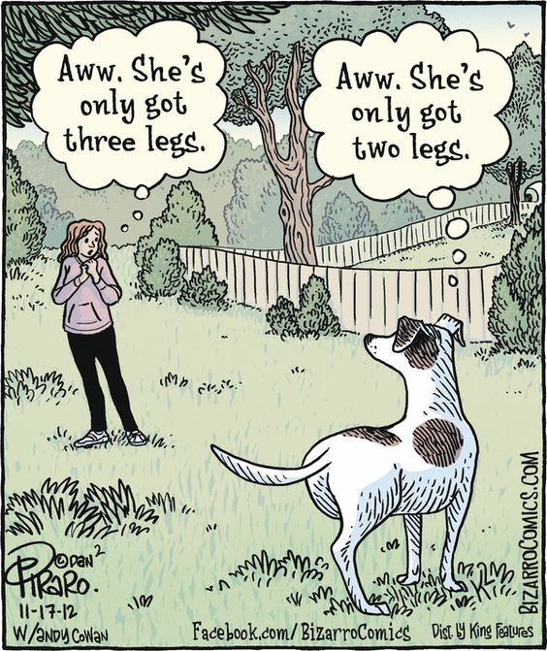
Break!
Come back in 10 min

Slide 8
Discussion 2
What do you think about the idea that PC is a new morality in a secular world?
How does it hold up as a moral system?
Does it ignore individuals to satisfy righteous indignation?
Is there a better way to heal the harm done in the past to non-dominant groups?
If it gets too off topic, find the commonality with the topic or just reset it back.
Try to get the widest perspectives from all the group.
Tease out good ideas
Provide a summary of your answers

Slide 9
Next time
Happiness – What does it take to get there?
Believing in Conspiracy Theories
Roles in the Fisher King
___________________

Slide 10
Wendy and Larry’s Ideas
Does our faith need to be tested to minister in our secular world?
Should we, as Christ followers, always be optimistic, no matter what is happening in our own personal lives or in the world?
Is there a problem with Christians buying into conspiracy theories? Should we avoid them and why?
Why are we tempted to put our hope in political and social agencies?
Is Biblical humility a forgotten (or even distained) virtue?
How do we counter spiritual contamination in our lives?
Is “compromise” a dirty word? When is compromise bad and when is it acceptable or good?
Why is it more important to be faithful than to be successful?
Can the short-term success of the wicked be God’s Will?
Why do we ignore what God forbids?
How will we manage as, Christ followers, as our society and culture becomes increasingly hostile toward Christianity and Christian values?
In our society and, at times in our churches, Bible values are not only rejected, it seems as if they are being attacked on every front. How do we, as Christ followers, respond?
One person stated: “I am not afraid to die; I just want to be the one who will decide when and how.” How should we, as Christ followers, respond to this?
Is political correctness paralyzing our churches and culture?
Is diversity good or bad for community cohesion? Diversity – gender, racial, ethnic or whatever is good? Companies that put a priority on the innovative are worth more when women hold top leadership positions. Fair or unfair?
Are we experiencing compassion fatigue as we are exposed to overwhelming needs in our society?
Gender challenges affecting churches and how do we respond?

