Slide 1
Happiness: Self-Help/Self-Aware
Gateway Baptist Church
6 November 2017

Slide 2
Introductions
What is your name?
What is the name of a fond relative or distant friend and why did you mention that person (very briefly)?

Slide 3
Why We Are Here
If your religion is so great, it can withstand some questioning.
“That sums up my problem with Scientology—despite its claims to the contrary, the practice doesn’t help you better the world or even yourself; it only helps you be a better Scientologist.” ― Leah Remini, Troublemaker: Surviving Hollywood and Scientology

Slide 4
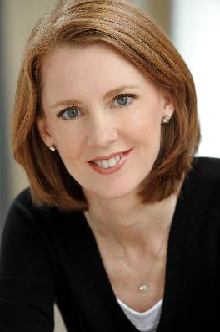
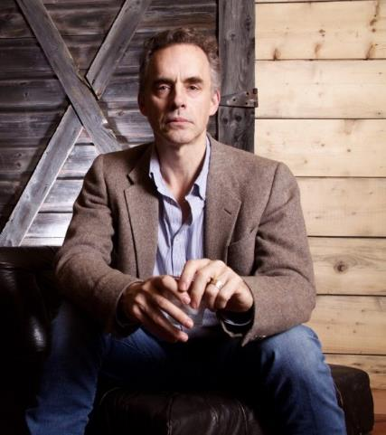
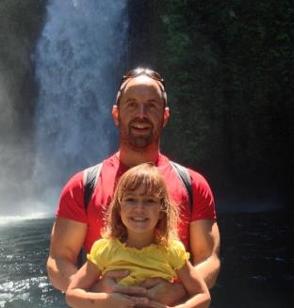
Gretchen Rubin
“The Happiness Project”
Jordan Peterson
“Maps of Meaning”
Todd Kashdan
“Designing Positive Psychology”
Daniel Polish
“Talking About God”

Slide 5
The Happiness Project
Or, Why I Spent a Year Trying to Sing in the Morning, Clean My Closets, Fight Right, Read Aristotle, and Generally Have More Fun.
It spent more than two years on the New York Times bestseller list, including hitting #1, has sold more than 1.5 million copies, and has been published in more than thirty languages.

Slide 6
The Happiness Project: What’s wrong with it?
How do you know that your life is moving in the right direction?
In our age without authority, I decide for myself.
Happiness doesn’t prepare us for life.
In our age without direction, I can’t plan for the future.
You shouldn’t be happy in sad circumstances.
In our age without defined morals, I decide what should be.

Slide 7
Discussion
The Self-help culture spends a lot of time looking for happiness, but apparently not finding it (otherwise they wouldn’t keep looking). Is that a fair criticism?
What if the same criticism is applied to the modern Church?
Looking for happiness?
Have you found what you are looking for?
To what extent is the purpose of the Church to find happiness?
If the discussion gets too off topic, find the commonality with then topic or just reset back.
Try to get the widest perspectives from all the group.
Tease out good ideas
Provide a summary of your answers

Slide 8
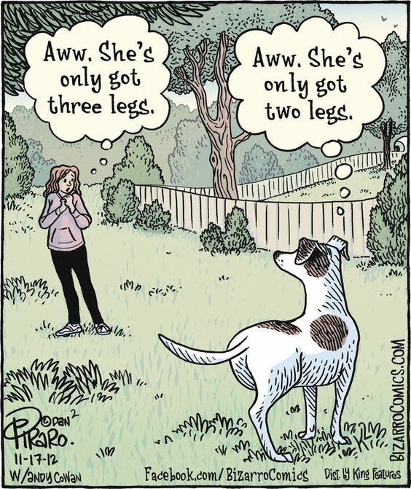
Break!
Come back in 10 min

Slide 9
Discussion
"My happiness grows in direct proportion to my acceptance, and in inverse proportion to my expectations."
Acceptance vs expectation vs duty vs resignation
(Emotion, will, neither ?)
To what extent do we shape our acceptance and expectations? To what extent do others around us shape them?

Slide 10
Discussion
Christianity has safeguards against people fooling themselves in their virtue. What are some examples and do they still work in the modern Church? Do you see parallels to them in THP or Self-help movements?
How is The Happiness Project (THP) like a Christian life of discipleship? How isn’t it?
THP emphasised greater morality, happiness, relationships, kindness, and the freedom to recover from setbacks. That sounds a lot like Christian life.
“Some people will tell you that the purpose of life is to be happy and those people are idiots” (22min) Is this comment fair?
Alexander Solzhenitsyn “Happiness is something that's done in by the first harsh blow that reality deals you.”

Slide 11
Next time
Believing in Conspiracy Theories
Roles in the Fisher King
The End of Realism
Scientism

Slide 12
Wendy and Larry’s Ideas
Does our faith need to be tested to minister in our secular world?
Should we, as Christ followers, always be optimistic, no matter what is happening in our own personal lives or in the world?
Is there a problem with Christians buying into conspiracy theories? Should we avoid them and why?
Why are we tempted to put our hope in political and social agencies?
Is Biblical humility a forgotten (or even distained) virtue?
How do we counter spiritual contamination in our lives?
Is “compromise” a dirty word? When is compromise bad and when is it acceptable or good?
Why is it more important to be faithful than to be successful?
Can the short-term success of the wicked be God’s Will?
Why do we ignore what God forbids?
How will we manage as, Christ followers, as our society and culture becomes increasingly hostile toward Christianity and Christian values?
In our society and, at times in our churches, Bible values are not only rejected, it seems as if they are being attacked on every front. How do we, as Christ followers, respond?
One person stated: “I am not afraid to die; I just want to be the one who will decide when and how.” How should we, as Christ followers, respond to this?
Is political correctness paralyzing our churches and culture?
Is diversity good or bad for community cohesion? Diversity – gender, racial, ethnic or whatever is good? Companies that put a priority on the innovative are worth more when women hold top leadership positions. Fair or unfair?
Are we experiencing compassion fatigue as we are exposed to overwhelming needs in our society?
Gender challenges affecting churches and how do we respond?

