Slide 1
The Power of Materialism
Gateway Baptist Church
20 November 2017

Slide 2
Introductions
What is your name?
In a word (or two): How was your day?

Slide 3
Why We Are Here
October 31st 1517 – The biggest change in the relationship between the church and Western culture
Now – The second biggest change (?)
The future – Western culture fails or The Gospel saves it

Slide 4
The Power of Materialism
Why “Power”?
Jesus says so. (And so does scientific studies.)

Slide 5
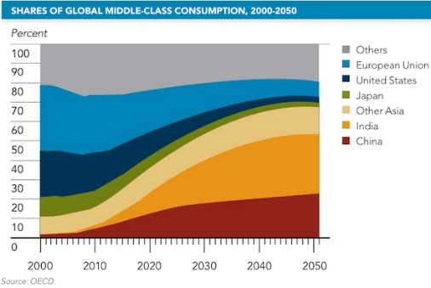
Growth of Materialism: timeline
Adam Smith The Wealth of Nations (1776)
Wealth comes from consumerism
Suburbs (1880 – 1970)
You can have your own estate
Henry Ford (1890 – 1910)
Cars for everyone
Edward Bernays (1920s to 1950s)
Your life can be better with stuff
George W Bush (shortly after Sept 11, 2001)
The most patriotic thing you can do is to shop

Slide 6
The High Price of Materialism
https://www.youtube.com/watch?v=oGab38pKscw&t=2s

Slide 7
The Power of Materialism
Possible Discussion directions:
Marketing manipulation
Minimalism
Environmentalism
Shopping as a dopamine addiction
Rising number of middle class worldwide
Envy

Slide 8
The Power of Materialism
Am I materialistic when I …
buy thinking it increases my social status
tell myself and others that I am buying for quality, but I am secretly going for status
buy thinking to increase my class and culture
think I am buying for quality only because of marketing
save for my family and future without considering others

Slide 9
Discussion
Marketing: Every purchase represents something.
Which purchases represent, which don’t represent something?
Needs vs wants:
Should we give to the extent that we become poor? Where is the line?

Slide 10
Discussion
Marketing: Every purchase represents something.
Quality of life, practicality, class & culture, hope
Example: Kitchen gadgets that seem practical but don’t get used.
Example: I want to be proud of my home to visitors
Which purchases represent, which don’t represent something?
Needs vs wants:
If I am saving up for it, do I need it? (Apparently not.)
If I have a hard time paying it off, do I need it?
How can I exchange my wants to satisfy others’ needs?
Should we give to the extent that we become poor? Where is the line?

Slide 11
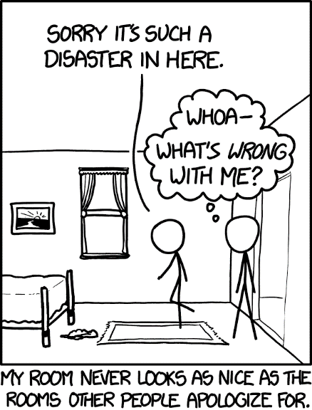
Break!
Come back in 10 min

Slide 12
Next time
Science and Miracles
Believing in Conspiracy Theories
Roles in the Fisher King
The End of Realism
Scientism

Slide 13
Wendy and Larry’s Ideas
Does our faith need to be tested to minister in our secular world?
Should we, as Christ followers, always be optimistic, no matter what is happening in our own personal lives or in the world?
Is there a problem with Christians buying into conspiracy theories? Should we avoid them and why?
Why are we tempted to put our hope in political and social agencies?
Is Biblical humility a forgotten (or even distained) virtue?
How do we counter spiritual contamination in our lives?
Is “compromise” a dirty word? When is compromise bad and when is it acceptable or good?
Why is it more important to be faithful than to be successful?
Can the short-term success of the wicked be God’s Will?
Why do we ignore what God forbids?
How will we manage as, Christ followers, as our society and culture becomes increasingly hostile toward Christianity and Christian values?
In our society and, at times in our churches, Bible values are not only rejected, it seems as if they are being attacked on every front. How do we, as Christ followers, respond?
One person stated: “I am not afraid to die; I just want to be the one who will decide when and how.” How should we, as Christ followers, respond to this?
Is political correctness paralyzing our churches and culture?
Is diversity good or bad for community cohesion? Diversity – gender, racial, ethnic or whatever is good? Companies that put a priority on the innovative are worth more when women hold top leadership positions. Fair or unfair?
Are we experiencing compassion fatigue as we are exposed to overwhelming needs in our society?
Gender challenges affecting churches and how do we respond?

