Slide 1
The “Modern” Role of the Church
Gateway Baptist Church
7 February 2018

Slide 2
Why are we here?
Last September, we talked about disenchantment: how rational and industrial progress are making it harder for people to think and relate spiritually.
Today we are going to look at how that progress set up a straw-man version of Christianity to knock down. The same sentiments are still around.

Slide 3
Do you know where the word “fundamentalism” comes from?

Slide 4
Do you know where the word “fundamentalism” comes from?
Around 1910 as a lay-person’s reaction to liberalism (Higher Criticism) denials in seminaries of:
The inspiration of the Bible by the Holy Spirit and the inerrancy of Scripture as a result of this.
The virgin birth of Christ.
The belief that Christ's death was an atonement for sin.
The bodily resurrection of Christ.
The historical reality of Christ's miracles.

Slide 5
What Happened?
Since the Middle Ages, Western Culture has had progress as an ideal. Empowered by the industrial and scientific revolutions, leading thinkers tried to turn the ideal of progress into present reality wherever they could. Progress without the foundation of tradition.
Notes:
Ex: Publicly denouncing other people’s sins, giving them an opportunity to repent

Slide 6
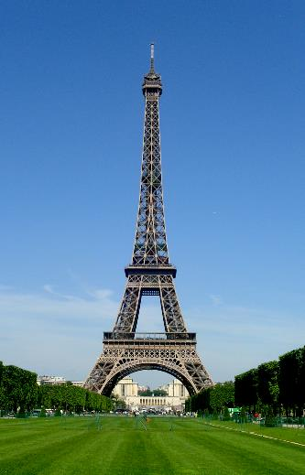
Eiffel, Disney, and Freud
Eiffel: use modern materials and techniques to surpass the height of cathedrals and pyramids.

Slide 7
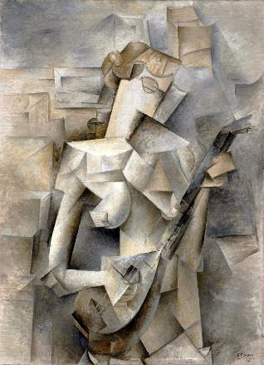
Eiffel, Disney, and Freud
Freud: Abstract from case studies to laws of nature for mental illness.

Slide 8
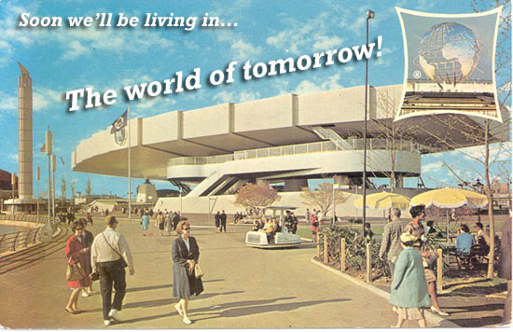
Eiffel, Disney, and Freud
Disney: Leaders of science, technology, and industry will create the best possible living environment. It will be cloned to create perfect community.
References:
Inside Walt Disney's Ambitious, Failed Plan to Build the City of Tomorrow
Imagineering the Future: Walt Disney's Obsession with Building a Better Tomorrow

Slide 9
What is the use of Christianity? (According to Modernism)
A template for social order and morality
Myths for children and the uneducated
Until someone gets a better idea, the de facto reason behind unexplainable notions:
creation, consciousness, laws of nature

Slide 10
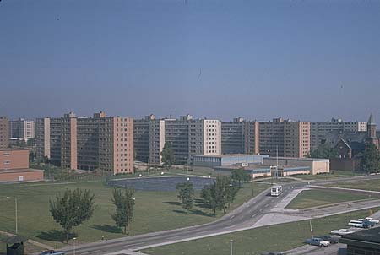
Modernism failed
“Social Darwinism” → eugenics
Technology → nuclear and biological threats
Tuskegee syphilis experiment
McJobs
Pruitt-Igoe

Slide 11
Questions
1. How is the modern (Western) church more complacent than we read from Jesus and the disciples? Is it from following the form of church, instead of the life within?
2. When the Bible talks about church politics, how is it different than today?
3. When you meet people who think they know Christianity, but are missing the Gospel, how do they describe church?
4. When you think of the word "Gospel", how is that different from common ideas of the Church?
5. If you have experienced church in a non-Western/European way (maybe on a mission), what words would you use to describe how it is different?

